Slide 1
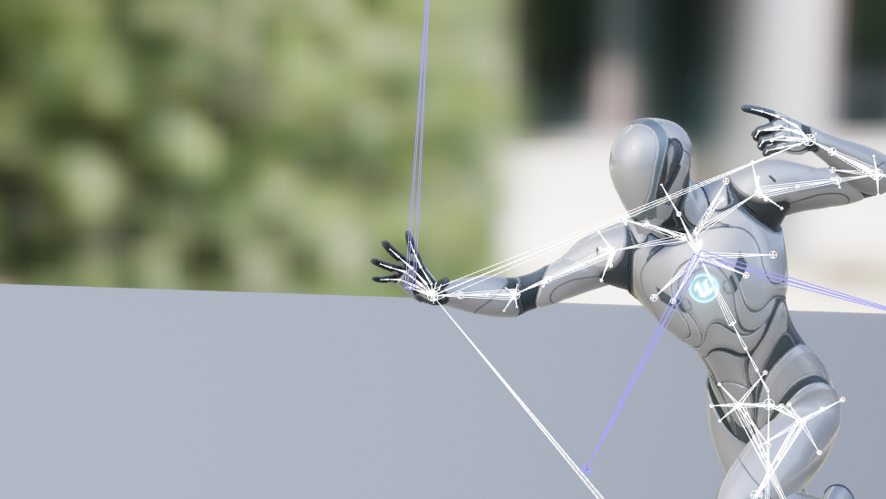
UNREAL NEURAL
Runtime Animation Generator
Unreal Engine Plugin

Slide 2
Introduction
Pipeline & Progress
Project Progress
Future Work
Contents
Notes:
이번주 발표 목차
.Intro 에선ㄴ 간단히 objective, usability, team members 등을 소개할것임.
이후 pipeline & progress 에서 전체적인 프로세스를 보여주고
이후 하나하나씩 나아갈거임 ㅇㅇ

Slide 3
Objective
Usability
Team Members
Development Schedule
Introduction
Notes:
Intro 에선 간단히 objective, usability, team members 등을 소개할것임.

Slide 4
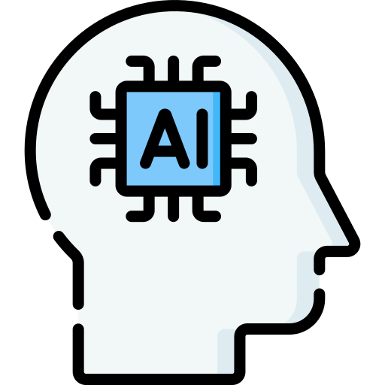
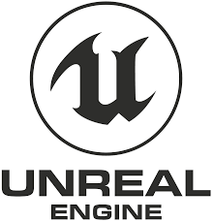

Objective
Unreal Engine
Plugin
Notes:
우리 프로젝트 목적 간단 요약
생성 모델을 사용해서 언리얼엔진 런타임에 애니메이션을 생성하여 캐릭터에 적용하는
언리얼엔진 플러그인 개발

Slide 5
Usability
Reduction of time for creating animation for developers.
Potential for new game system and contents.
Expansion of user's game/metaverse experience through customized animations of their own.
Notes:
우리 플러그인이 사용될 수 있는 분야
개발자들의 애니메이션 제작 시간 단축
새로운 게임 시스템, 컨텐츠의 가능성
유저가 개인화된 애니메이션을 제작할 수 있게 됨으로써 유저들의 게임/메타버스 경험 확장

Slide 6
Team Members
CV/AI
박수호, 차승종: Motion Diffusion Model performance improvement, Data collection, Model training.
Unreal Engine
이재훈: Adjustment of model to Unreal Engine.
제해찬: Motion data processing
조용현: Building demo project and implementing plugin functions
Notes:
팀 멤버 목록 및 역할

Slide 7
Development Schedule
 | Week 3 | Week 4 | Week 5 | Week 6 | Week 7 | Week 8 | Week 9 | Week 10 | Week 11
Retargetting Animation (Skeleton)
Model performance and speed improvement
Adjustment model to Unreal Engine
Implement plug-in function library
Implement simple demo
Packaging and deploy
Notes:
개발 일정 (대충 가라로)

Slide 8
Model & Data Augmentation
Using Model in Unreal Engine: ONNX
Runtime Animation Importing
Animation Retargeting
Project
Progress
Notes:
이번주 발표 목차
.Intro 에선ㄴ 간단히 objective, usability, team members 등을 소개할것임.
이후 pipeline & progress 에서 전체적인 프로세스를 보여주고
이후 하나하나씩 나아갈거임 ㅇㅇ

Slide 9
Motion Diffusion Model
Text Input
Model
Motion Data
Dimension
Conversion
FBX Data
Pipeline
&
Progress
Text Input
ONNX
Model
Motion Data
Dimension
Conversion
Motion
Data
Implemented
Working on
Not started yet
Animation
State
Retargeting
Animation
Sequence
Runtime
Importer
Unreal Engine
Notes:
프로젝트 파이프라인과 현재 진행 상황
크게 모션디퓨전 모델 파트와 언리얼엔진파트로 나눠서 생각해볼 수 있다
검은 선은 구현된 부분 또는
주황 선은 현재 작업 중인 부분
회색 선은 아직 시작안한 부분

Slide 10
Motion Diffusion Model
1
Text Input
Model
Motion Data
Dimension
Conversion
FBX Data
Model
Text Input
ONNX
Model
Motion Data
Dimension
Conversion
Motion
Data
Animation
State
Retargeting
Animation
Sequence
Runtime
Importer
1.
Unreal Engine
Notes:
모델 파트부터 설명 시작

Slide 11
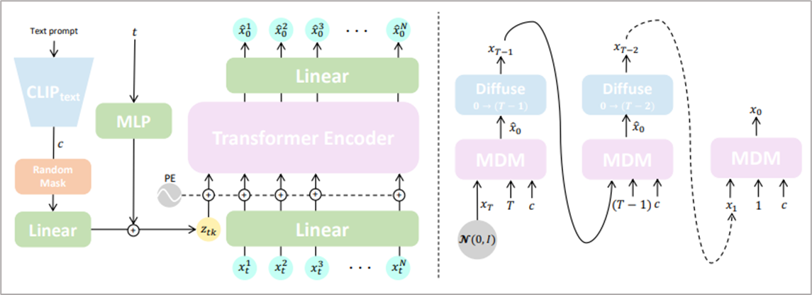

Model Description
What is Motion Diffusion Model?
A diffusion-method based model generating human motion
Denoise process
Noise process
Notes:
디퓨전 모델의 방법을 통해서 모션을 생성하는 모델이 MDM이다.
일단 디퓨전 모델은 학습할 데이터에 인위적으로 noise를 추가해서 noise한 데이터를 만들고 그 noise로 부터
Denoise과정을 거치면서 데이터를 생성하는 방법을 활용한다.
신기하게 이모델은 text 인풋으로 학습을 할 수 있는데 이는 모델이 학습하는 과정에서 텍스트와 관련된 데이터만 골라서 학습하기 때문이다.
추가적으로 denoising과정에서 transformer 구조를 활용

Slide 12
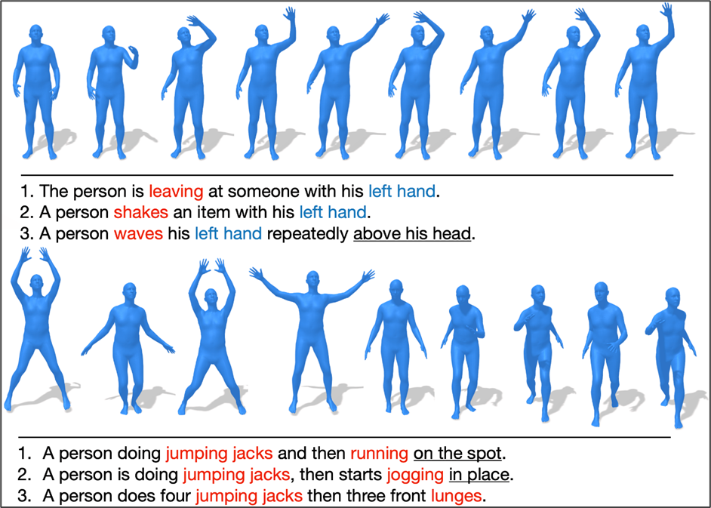
Dataset
HumanML3D: 3D Human Motion-Language Dataset
Notes:
HumanML3d는 사람의 모션을 글로 설명한 데이터 셋이다.
The dataset has several text captions for one motion.

Slide 13
Data Augmentation
Why dataset need augmentation?
Because there is long tail problem in the dataset
The number of words that express emotions is unbalanced
Key word | Number of key words in dataset
aggressively | 64
angrily | 46
sadly | 12
unhappily | 0
Notes:
Long tail problem이 있었기 때문에 이를 해결해주기 위해서 augmentation이 필요하다.
이때 감정표현을 나타내는 것이 목적이었고 이 감정표현을 나타낼 수 있는 다양성을 늘릴 필요가 있디

Slide 14
Data Augmentation
How augmentation?
If we use similar words that express similar emotion, we can increase the number of dataset
a person walks sadly towards the screen then pivots and walks back to the top.
= a person walks unhappily towards the screen then pivots and walks back to the top.
a man aggressively kicks an object to the left using his right foot
= a man angrily kicks an object to the left using his right foot
Notes:
어그멘테이션을 통해 데이터 간의 불균형을 맞추기 위해서는 유사한 언어가 필요함

Slide 15
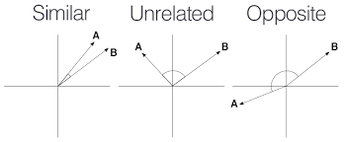
Data Augmentation
How to select similar words?
Using word2vec model which convert word to vector
The model was trained from Google news dataset with 3 million words and phrases
Why words need to be vectors?
We can use cosine similarity if word is converted to vector
High cosine similarity means those two words has similar meaning
Notes:
인공지능의 힘을 빌림 -> 단어를 벡터로 바꾸면 코사인 시밀러리티를 볼 수 있기 때문에 데이터 셋에서 가장 유사한 단어를 찾는데 유리히다ㅏ.

Slide 16
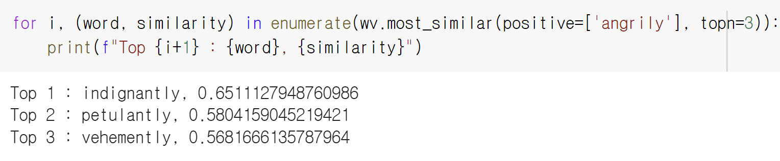
Data Augmentation
Results of finding similar words
Notes:
유사한 단어를 찾은 결과ㅡ-> 따라서 이 단어들을 통해 데이터를 어그멘테이션 진행

Slide 17
Motion Diffusion Model
2
Model With UE: ONNX
Text Input
Model
Motion Data
Dimension
Conversion
FBX Data
Text Input
ONNX
Model
Motion Data
Dimension
Conversion
Motion
Data
Animation
State
Retargeting
Animation
Sequence
Runtime
Importer
2.
Unreal Engine
Notes:
Second part is about using motion diffusion neural network model in unreal engine.

Slide 18
Model With UE: ONNX
What is ONNX?
Open Neural Network Exchange
We can convert PyTorch model to ONNX
No environmental dependencies
Why ONNX?
UE provide NNI plugin for running ONNX model.
We can run a ONNX model in UE.
Notes:
Onnx is an open format built to represent machine learning models.
This is example code that running style transfer onnx model in unreal engine.
Unreal engine provide NNI(neural network inference) plugin that enable us to use neural network model.

Slide 19
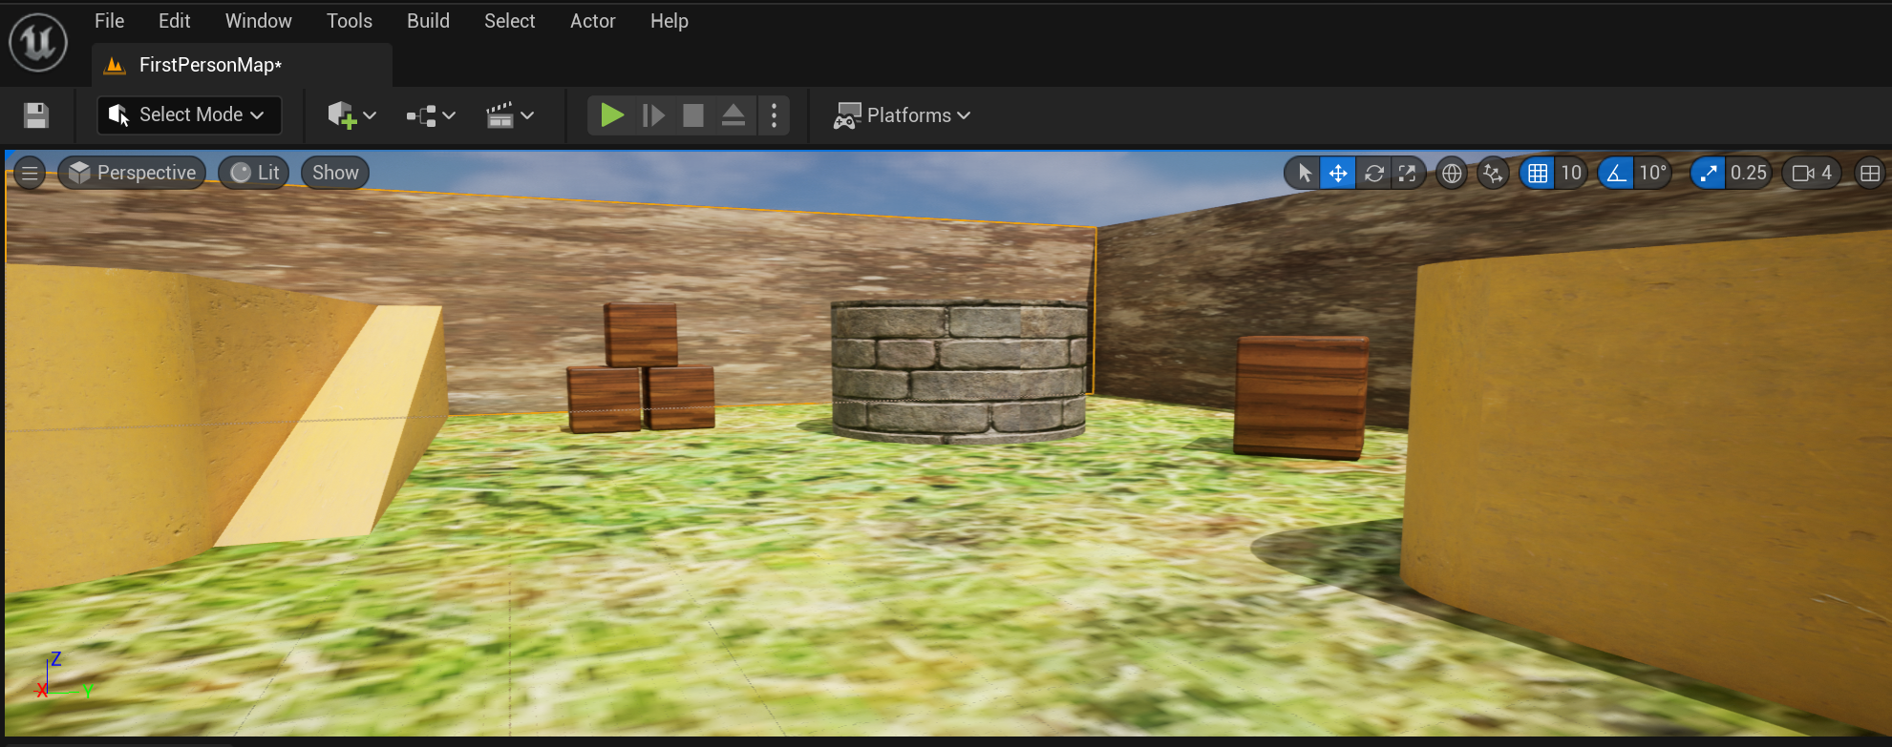
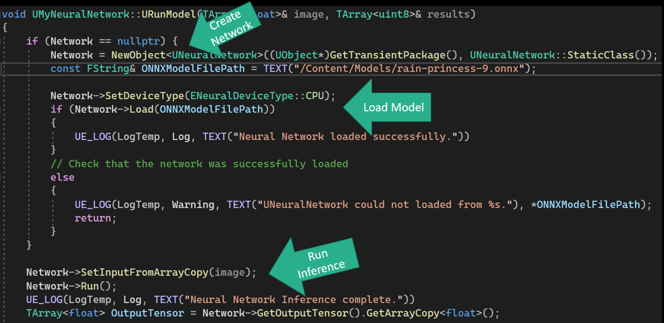
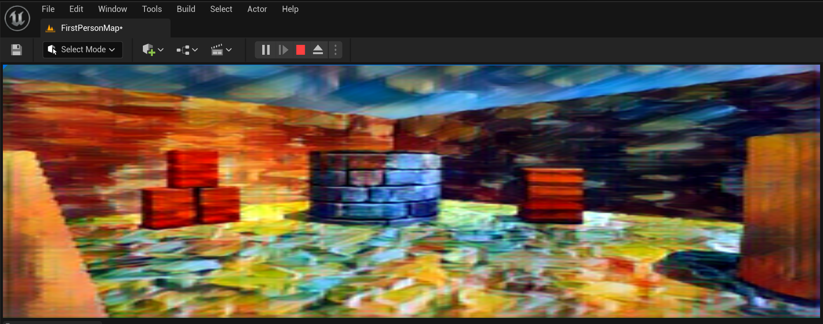
Model With UE: ONNX
ONNX Example: Style Transfer
Notes:
As you see you can run the onnx model during runtime.

Slide 20
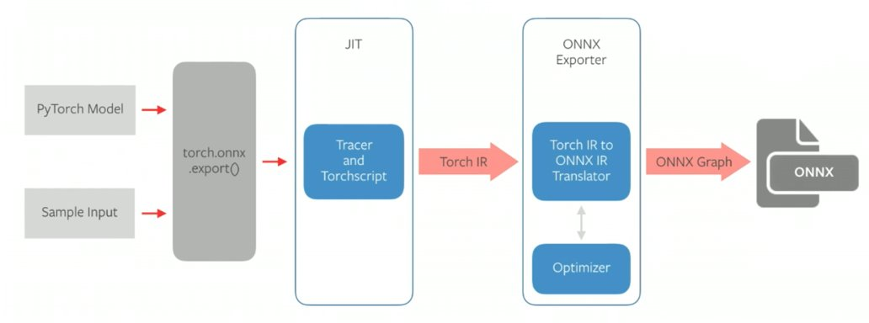
Model With UE: ONNX
How to export model to onnx?
Pytorch model + Sample Input + export fuction
Notes:
Then how can we create onnx model?
By simply running export() function with sample input, we can export pytorch model into onnx model.
The dummy input is required to infer the shapes of tensors throughout the model.
Sample input is needed to create a static computational graph for the ONNX format

Slide 21
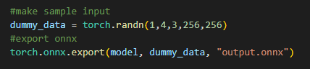
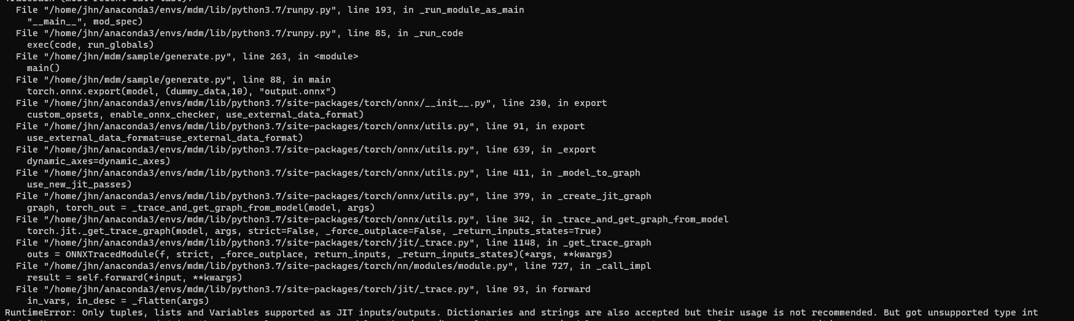
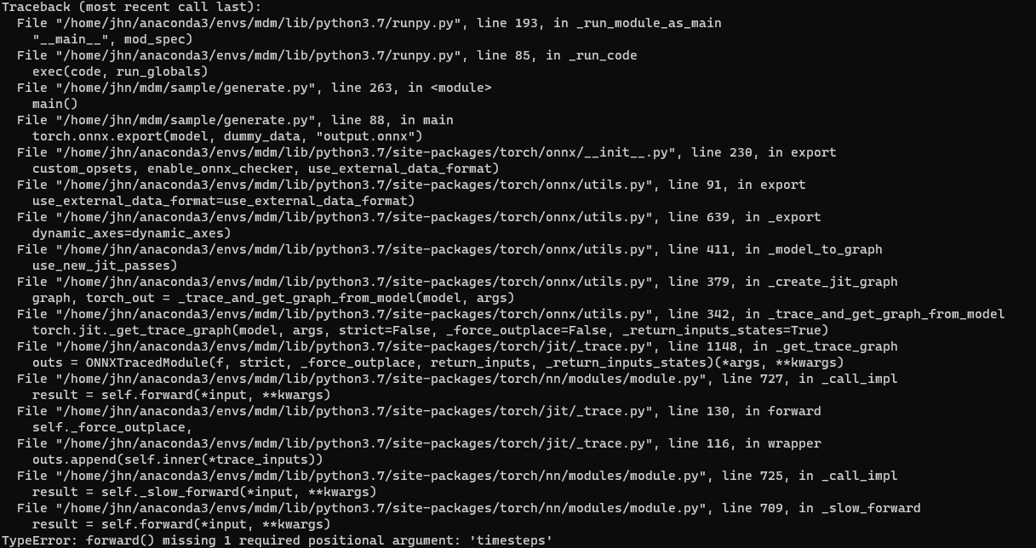
Model With UE: ONNX
Sample Input Error
Different type of sample input
Notes:
Although exporting implementation is simple, we are getting sequence of errors
We identified the error is involved with shape of sample input.

Slide 22
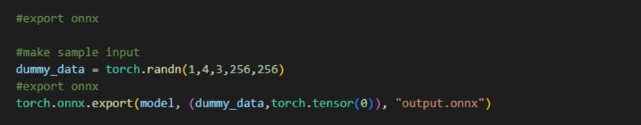
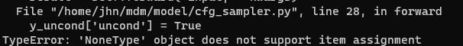
Model With UE: ONNX
Error Solved: input tensor modifying
Fitting input tensor (timesteps)
New Error:
Notes:
Turns out, it needs additional input of timestep, so we included timestemps in the sample input.
And we got another error.

Slide 23
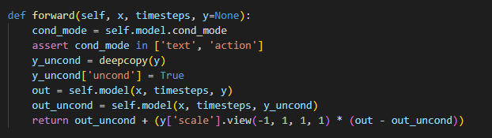
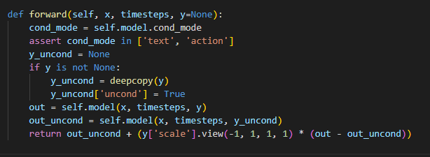
Model With UE: ONNX
Error Solved: Modifying forward function
Notes:
새로운 에러는 model 의 forward function 관련해서 이슈가 생긴것 같음.
Forward function code를 수정하여 이 에러는 고쳤지만

Slide 24
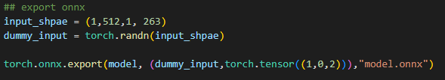
Model With UE: ONNX
Dealing with New Errors: input tensors
Modifying input tensors
Notes:
We are getting new errors involved with input tensor.
We keep working on this problem for now.

Slide 25
Motion Diffusion Model
Text Input
Model
Motion Data
Dimension
Conversion
FBX Data
Runtime
Animation
Importing
3
Text Input
ONNX
Model
Motion Data
Dimension
Conversion
Motion
Data
Animation
State
Retargeting
Animation
Sequence
Runtime
Importer
3.
Unreal Engine
Notes:
Where motion data imported to unreal engine, during runtime.

Slide 26
Runtime Animation Importing
Motion Data FBX
Assimp
Library
Motion
Data
Runtime
Importer
Animation
Sequence
ONNX
Model
Motion Data 6D
Dimension
Conversion
Notes:
There are two way of importing motion data we can implement.
First is using assimp library to parse fbx motion data in unreal engine. This is currently implemented.
Second is importing motion data from onnx model after converting 6 dimensional data. As we haven’t exported onnx from pytorch yet. It’s not on track yet.

Slide 27
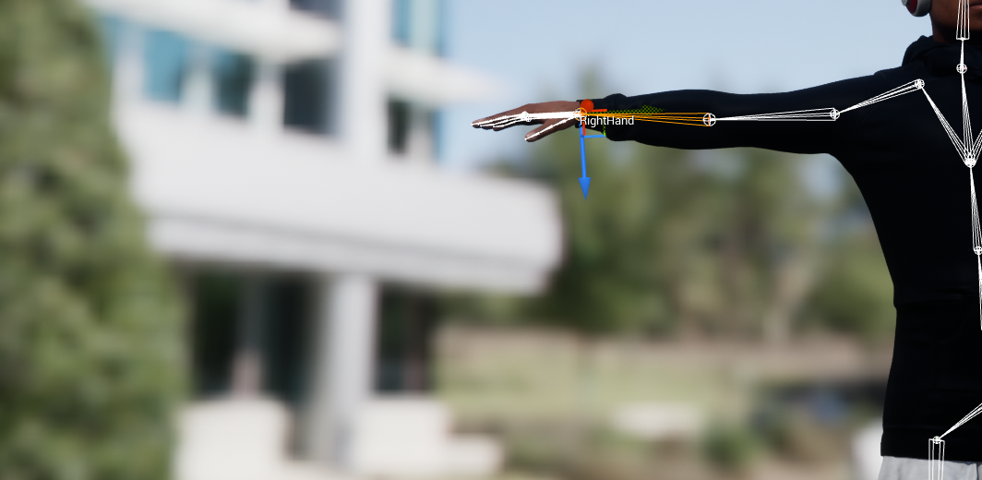
Runtime Animation Importing
Importing FBX motion data
Parse motion data by ASSIMP
Construct UAnimSequence* class
Animate Prepared Skeleton
Get motion data of the bone with the same name in FBX
(e.g) Find motion data of ‘RightHand’ in FBX and apply it to prepared skeleton.
Motion data:
# of bones
Duration
Framerate
For each bone:
Bone name
Initial Position
Rotation in every frame
Notes:
Let me summarize how motion importing is done with fbx format.
By using ASSIMP lib, we can parse motion data of each bone.
We have prepared skeleton. Find a bone in fbx data with our skeleton.
For example, our skeleton has ‘righthand’ bone.
We search ‘right hand’ bone name in fbx and get motion data of it. And then, apply the data to our prepared skeleton.
By moving skeleton with the motion data we can create animation sequence.

Slide 28
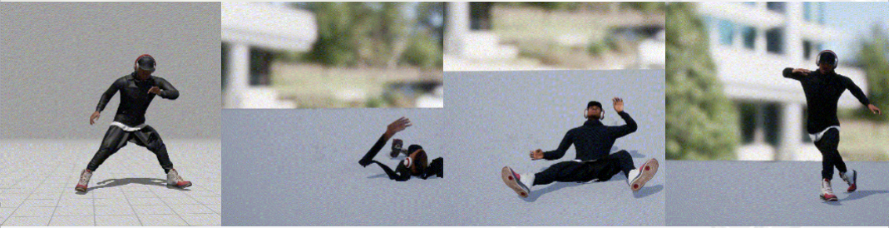
Runtime Animation Importing
FBX Source
First Import
Pos & Rot Fix
Root Rot Fix
Notes:
it happens because the fbx model use different axes convention from unreal engine.
Only rotation of root node should be edited. Because every other bones under the root bones will follow root bone.

Slide 29
Motion Diffusion Model
Text Input
Model
Motion Data
Dimension
Conversion
FBX Data
Animation
Retargeting
Text Input
ONNX
Model
Motion Data
Dimension
Conversion
Motion
Data
4
Animation
State
Retargeting
Animation
Sequence
Runtime
Importer
4.
Unreal Engine
Notes:
Retargeting. to apply animation to other characters that has different bone hierarchy.

Slide 30
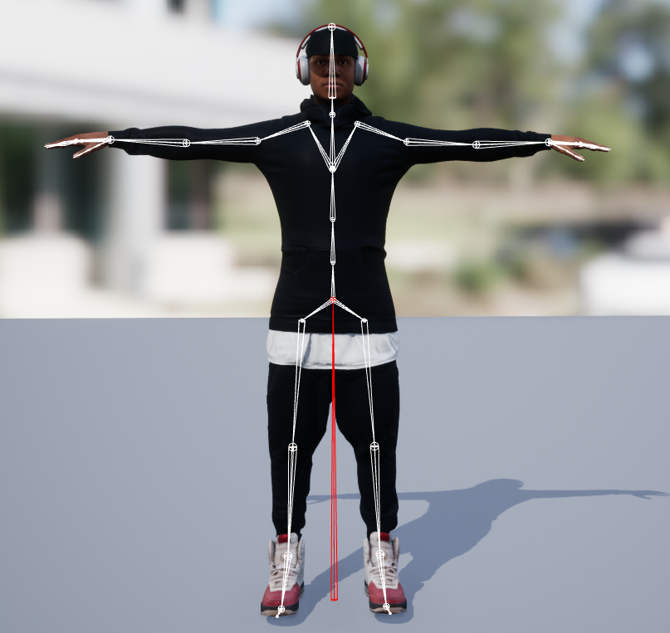
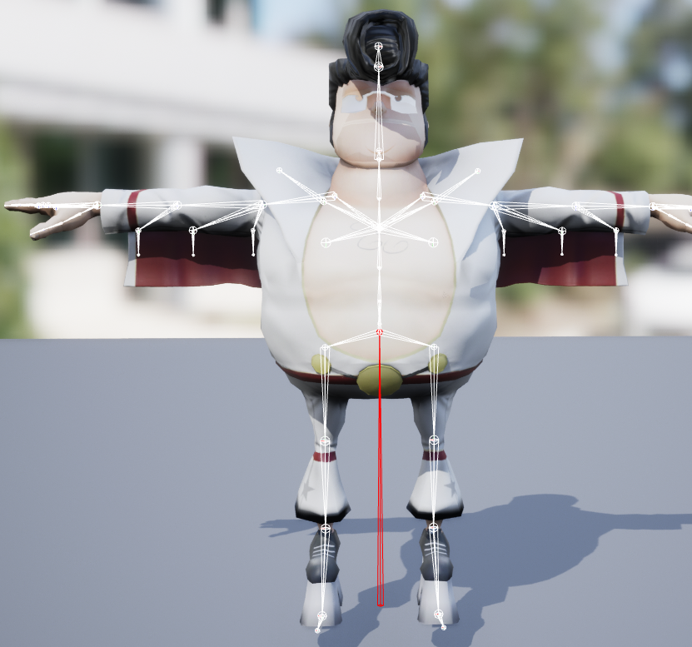
Animation Retargeting
Source
Target
Notes:
Let’s start with example. These two character use different bone hierarchy. The character on the right has more bone node to represent clothes and body shape. And proportion is different too.
We want to transfer animation of source, left, to the target on the right.

Slide 31
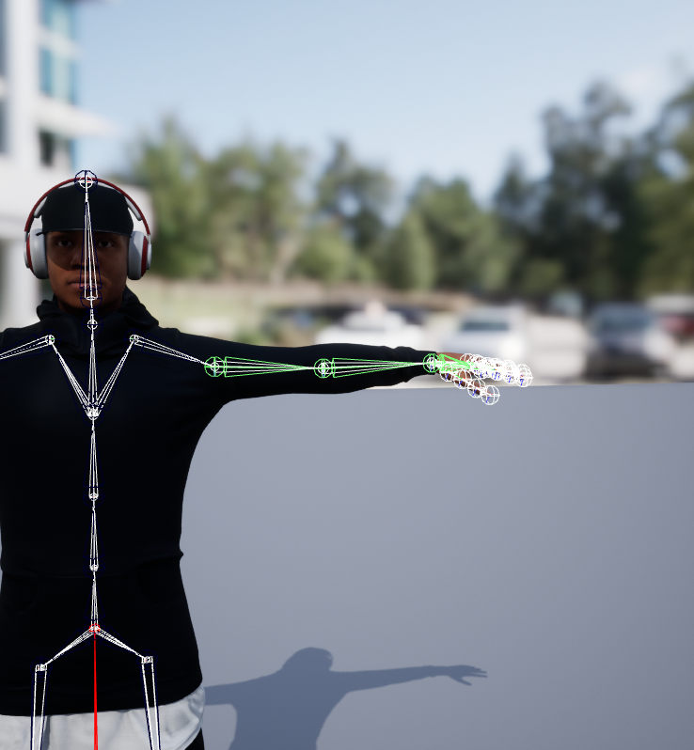
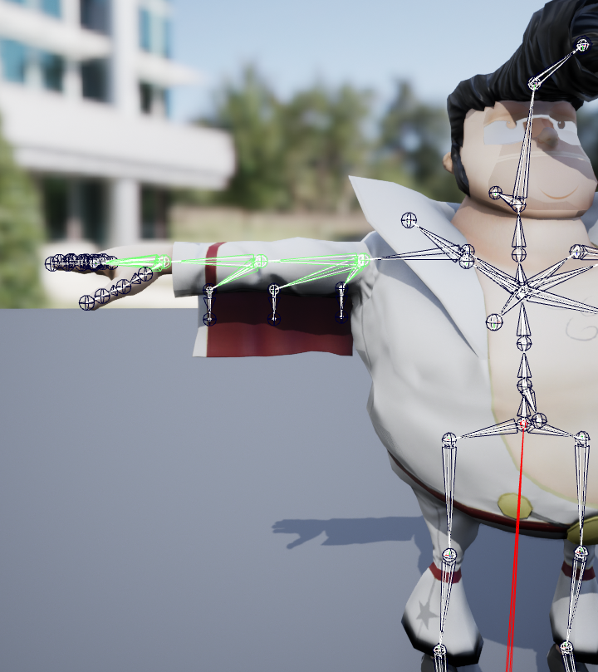
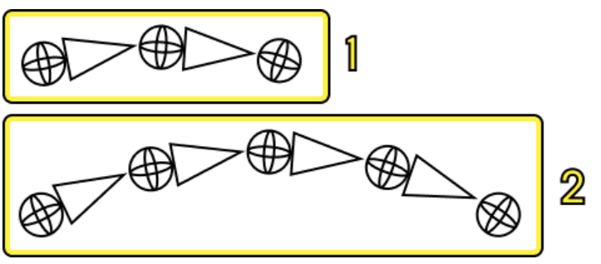
Animation Retargeting
Source bone chain
Target bone chain
IK Rig 1
IK Rig 2
Notes:
We define bone chains. By matching target and source bone chain, we can match animation for chains we want.
These bone chain information is defined IK rig assest.

Slide 32
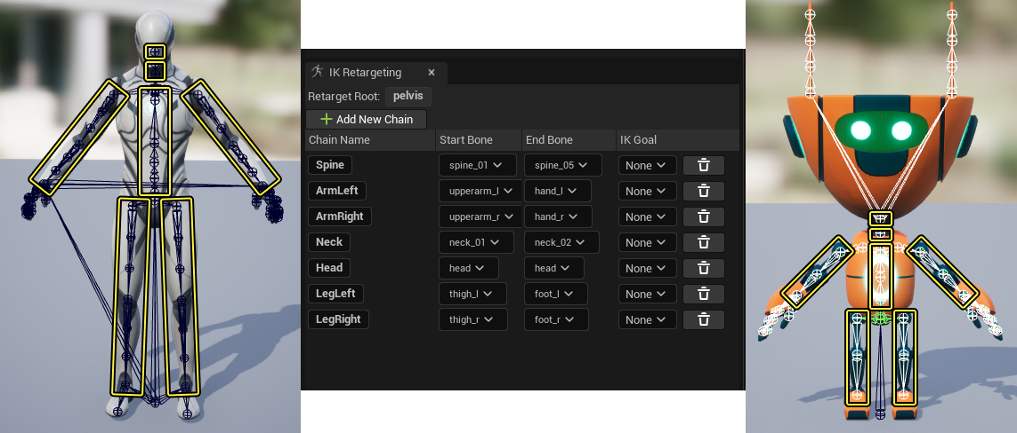
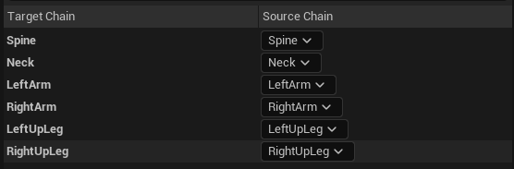

Animation Retargeting
IK Rig Retargter
Notes:
We define all necessary bone chains. By matching target and source bone chains, we can properly retarget animation.

Slide 33
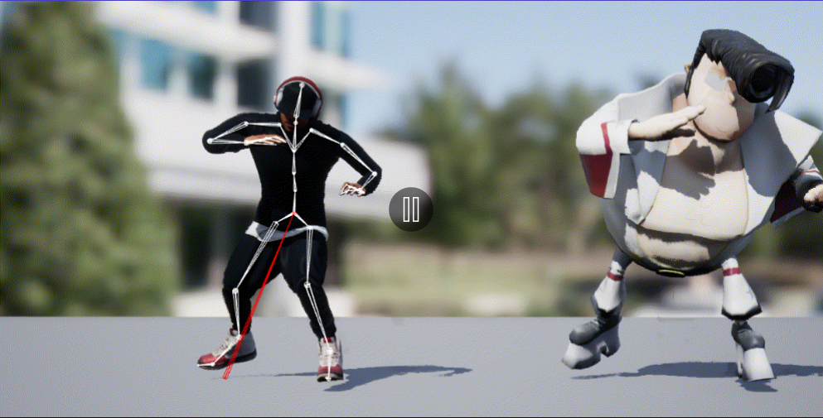
Animation Retargeting
Notes:
This is retargeting result of two character with different skeleton hierarchy
You can see even if proportion and hierarchy is different, animation is perfectly transferred.

Slide 34
Implementing ONNX in Unreal Engine
Model training with augmentation
Retargeting in runtime
Animation State
Future
Work

Slide 35
THANK YOU
UNREAL NEURAL

